Slide 1



Employee Database management System
By :
Nikhil Kumar
Dev Bhatia
Dhyey Shah

Slide 2
What is Employee database management system
Employee database management system is used to store data related to employees working in a Company.
Employee data can contain their personal info, position, financial info, demographic info etc.
It is faster than traditional ways to handle employee data as one can perform bulk operations on it, print it if needed, can access from anywhere etc.

Slide 3
Objective of the Project
To provide a simple, fast and robust method to manage employee data in MySQL Database with Python.
To simplify the operations that are performed on database.
To easily navigate between different operations.
To provide simple and easy to use controls

Slide 4
Problem Identification
The current way of storing employee database is either in physical form or some local storage.
It takes time to gather data.
Complicated and long search is required to find documents.
Data might be missing and might even be destroyed naturally over time.

Slide 5
Programming languages and software used
There are two major things that is used in this project –
MySQL - MySQL is an open source relational database management system (RDBMS) based on Structured Query Language (SQL). This project uses MySQL Database to store all the employee data.
Python - Python is a popular high-level, general-purpose programming language. This project uses Python to provide user interface between database and user.

Slide 6
Why Choose
MySQL as Database :
Free and open source
One of the most secure DBMS
High performance and workload management
Scalable according to requirements
Python as programming language :
High level language
User friendly
Concise syntax
Open source and Free
Cross Platform Support

Slide 7
Modules used in project
mysql-connector-python - MySQL Connector/Python enables Python programs to access MySQL databases, using an API that is compliant with the Python Database API Specification.
tabulate – Python tabulate module is a simple list to table convertor to view data in tabular form.
os - The OS module in Python provides functions for interacting with the operating system.

Slide 8
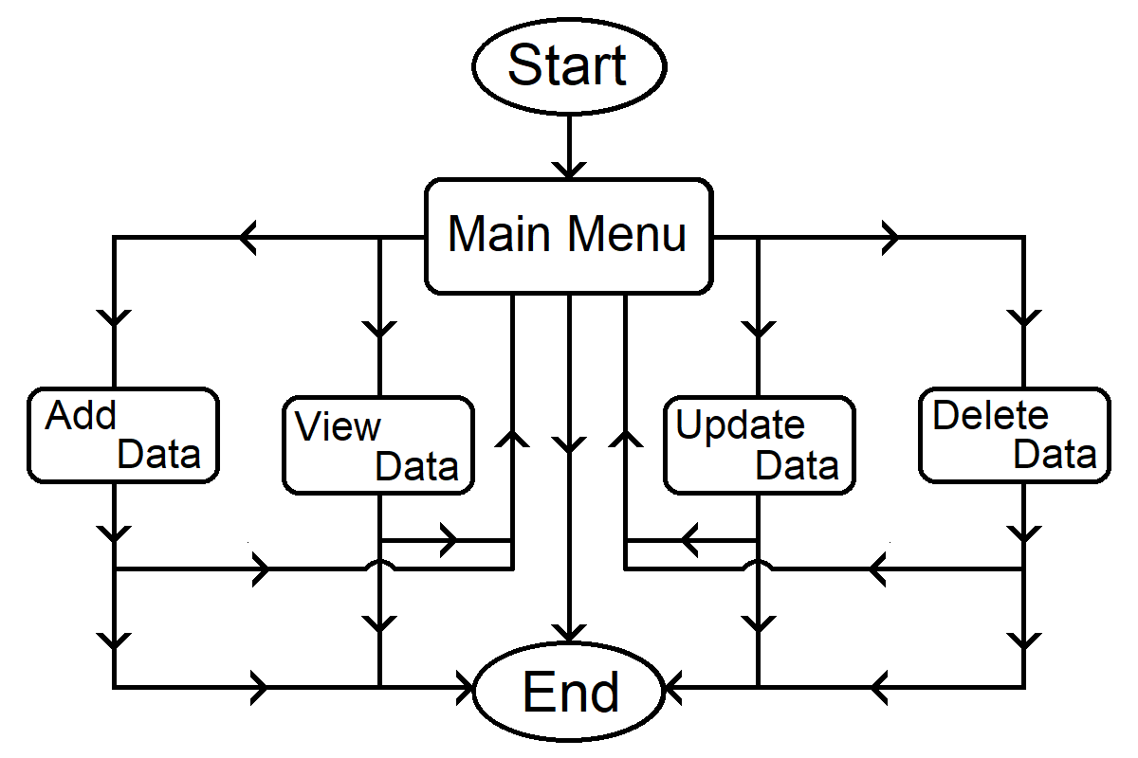
functional block diagram

Slide 9
Methodology
This project is a CLI Menu driven program using concept of functions and loops.
Menu-driven programs are interactive programs that take input from the users and perform actions according to their choice.
While making the applications easy to use menu driven programs also make them unambiguous by giving fixed choices to the user.

Slide 10
Operations
There are 4 major choices in this program -
View Employee data : To view the data present in database by sending commands to database and using table to present data.
Add Employee Data : To add employee data in database.
Update Employee Data : To update / delete data in database.
Quit : To quit the program.

Slide 11
Database Structure
Financial Information
Personal Information
Tables
Date of Birth
Father’s Name
Mother’s Name
Mobile Number
Address
Pincode
Country
Pay
Last Pay Date
Bonus
MAIN Information
Employee ID | Employee Name | Join Date | Division | Position

Slide 12
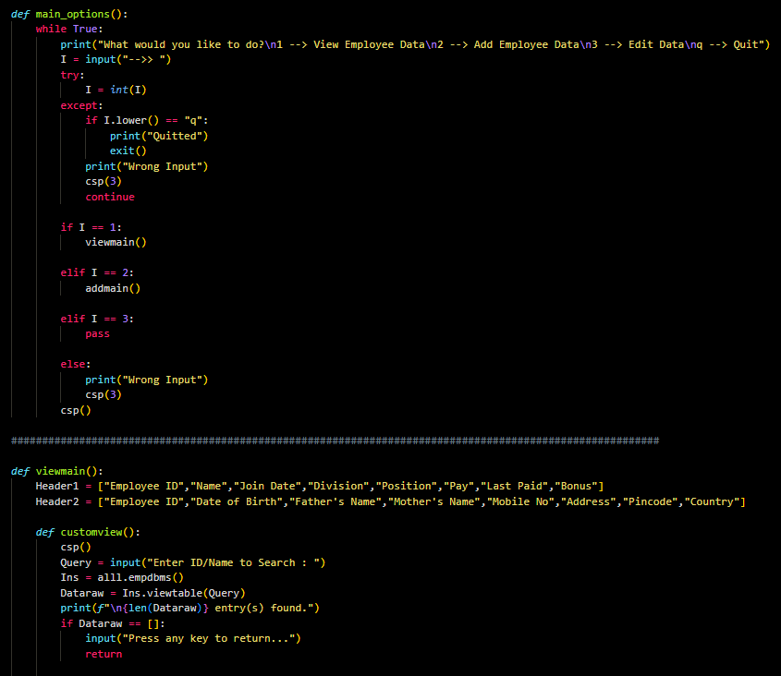
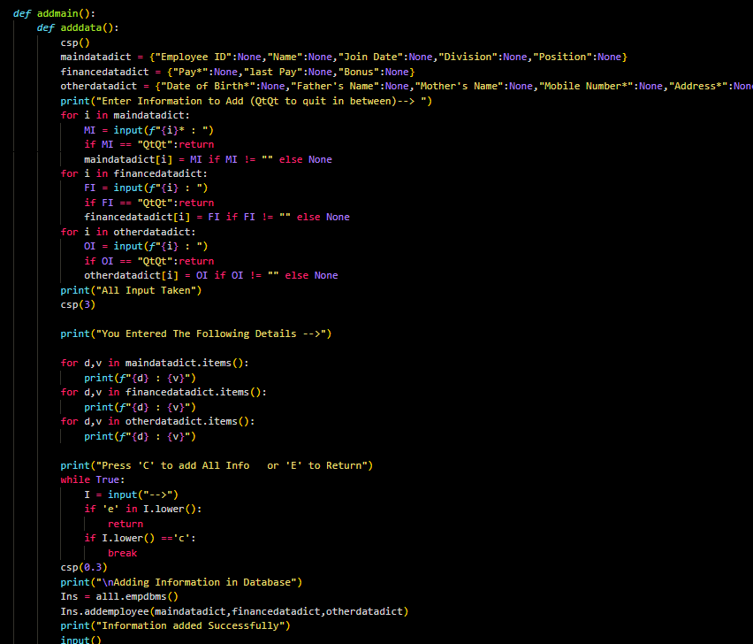
Code Snippet

Slide 13
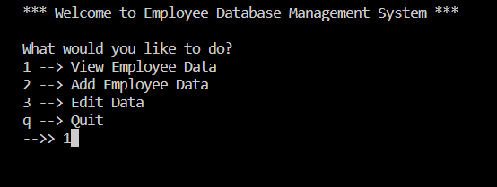
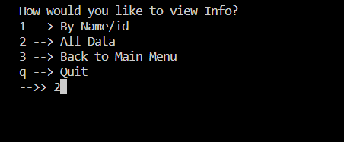
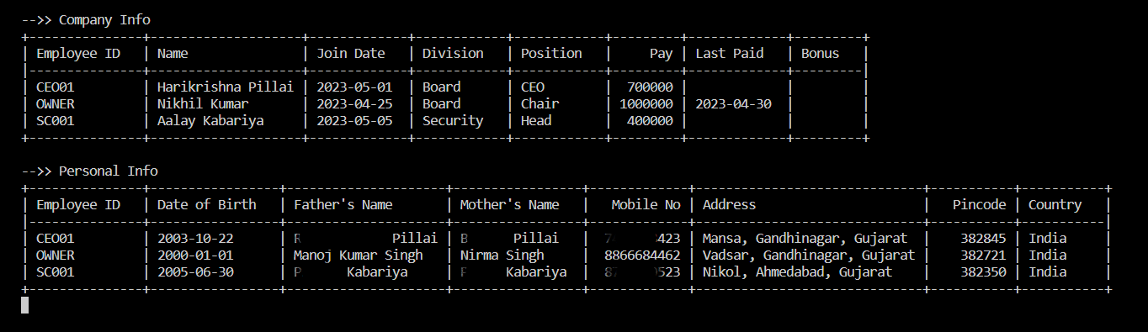
Sample Output

Slide 14
RESULT
Can easily perform CURD operations on database.
Takes minimal time to read and write information in database.
Takes minimal system resource to run.
Can Store and Retrieve huge amount of data quickly.

Slide 15
Conclusion
It provides computerised way to store employee data.
It is fast, reliable and easy to use.
The data is stored in secure MySQL Server so it ensure data safety.
Huge data storage in server and takes very less system resources to run.
Can be accessed from anywhere using internet connection.
GUI can be added to make it more appealing.

Slide 16
References
https://dev.mysql.com/doc/
https://docs.python.org
https://pypi.org/project/tabulate/

Slide 17
Thank you

